Slide 1
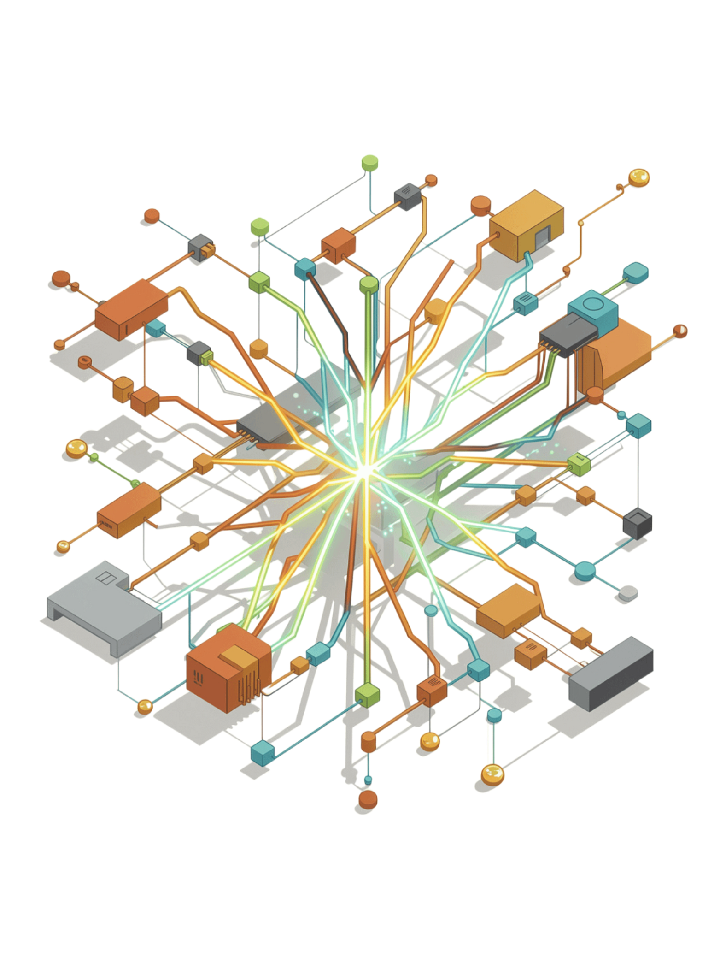
GPT-5 Prompt Engineering
Balancing Agentic Eagerness, Reasoning Effort, and Clarity of Instructions
Mugisha Timothy
Natuyamba Conrad
S25B38/041
S25B38/027
Mutagamba Jasmine Martha
S25B38/028

Slide 2

The Three Core Principles
Agentic Eagerness
Controls how proactive GPT-5 is—from tightly controlled behaviour to highly autonomous decision-making.
Reasoning Effort
Determines how deeply GPT-5 analyses a problem before producing answers, from minimal to high cognitive work.
Clarity of Instructions
Provides explicit goals, context, constraints, and expected outputs for predictable and reliable responses.

Slide 3


Understanding Agentic Eagerness
Definition
How proactive GPT-5 is when completing a task—searching for information, calling tools, or working autonomously.
High vs Low Eagerness
High: Searches multiple sources, makes autonomous decisions
Low: Uses only given information, waits for instructions
Key Insight
Should be calibrated, not maximized. Balance prevents unnecessary tool usage and incomplete tasks.
"Debug only the authentication module. Stop once you identify the root cause." — defines scope and stopping condition.

Slide 4
Understanding Reasoning Effort
Definition
How much deliberate analysis GPT-5 applies before responding—shaping the depth, accuracy, and completeness of the answer.
Four Levels
Minimal
Low
Medium
Default
High
Balance
Use the lightest effort that still delivers a reliable result. Low effort is faster for simple tasks; higher effort is better for complex problems, edge cases, or high-stakes decisions.

Slide 5



Understanding Clarity of Instructions
Task
Context
Constraints
What exactly should GPT-5 do?
Background information to guide the response.
Boundaries, scope, and limitations to enforce.
Output Format
Success Criteria
Define how the answer should be structured.
Define what a correct, complete response looks like.

Slide 6


The Balance Between Three Principles
Always Set Intentionally
Balanced prompts set all three intentionally for focused, efficient behaviour.
Clarity
Reasoning Effort
Agentic Eagerness
Always high — gives direction and anchors the response.
Adjust to task complexity — more for multi-step problems.
Calibrate to desired autonomy — avoid unnecessary actions.

Slide 7
Multi-Step Reasoning: Climate Change Example
Weak Prompt ❌
Better Prompt ✅
"Solve climate change."
Vague, impossible to scope, and gives GPT-5 no direction on depth, format, or audience.
"Analyse climate change adaptation for Uganda:"
Explain the primary causes
Compare three adaptation methods
Evaluate their impact on local communities
Recommend the best strategy for smallholder farmers
Why It Works
Tasks are ordered and scoped
Output format is defined
Success criteria are explicit
Logical reasoning flow is enforced

Slide 8
Expected GPT-5 Behaviour: Good vs Poor Prompts
POOR PROMPT
GOOD PROMPT
Poor Prompt
Good Prompt
Generic answer with missing steps
Shallow or unnecessarily verbose reasoning
Inconsistent and unpredictable format
Structured explanation with complete workflow
Appropriate reasoning depth
Predictable, consistent format
Clear Contrast
Readable Output
Side-by-side comparison makes the difference immediately visible.
Large, crisp text keeps both approaches easy to scan.
Output quality correlates directly with how well the three principles are implemented.

Slide 9
A Well-Crafted Prompt Example
Act as an experienced Data Science lecturer and mentor teaching a second-year Bachelor of Data Science and Analytics student at Uganda Christian University.
Explain, step by step, how to build a fraud detection machine learning model in Python using Scikit-learn and the Kaggle Credit Card Fraud Detection dataset. Assume the student knows Pandas, NumPy, Matplotlib, and basic Scikit-learn.
Cover the complete ML workflow: the business problem, dataset overview, classification and class imbalance, EDA, preprocessing, feature scaling, train-test split, handling imbalance, model training, evaluation, and interpretation.
Compare Logistic Regression and Random Forest, explaining how they work, their pros and cons, and when to use each. Include fully explained Python code, describing key functions, parameters, and modelling decisions.
Evaluate using confusion matrix, precision, recall, F1-score, and ROC-AUC, explaining why accuracy is misleading for imbalanced data. Highlight common mistakes (data leakage, scaling, train-test splitting, class imbalance, accuracy-only evaluation) and end with practical exercises and challenge questions.
The success criteria should be a clear, beginner-friendly, technically accurate guide that enables the student to reproduce and confidently explain the entire project in Jupyter Notebook.

Slide 10


A Well-Crafted Prompt Example
Role
Task
You are an experienced Data Science lecturer and mentor supporting a second-year Bachelor of Data Science and Analytics student at Uganda Christian University.
Teach the student how to build a fraud detection machine learning model using Python and Scikit-learn, based on the Kaggle Credit Card Fraud Detection dataset.
Context
Requirements
The student already understands Pandas, NumPy, Matplotlib, and the basics of Scikit-learn, but needs guidance on how to combine these skills into a complete end-to-end project.
Cover data cleaning, feature scaling, train-test split, model training, and class imbalance. Compare Logistic Regression and Random Forest, and include a confusion matrix, precision, recall, F1-score, and ROC-AUC. Also highlight common student mistakes and explain how to avoid them.
Output Format
Success Criteria
Present the answer as concept explanation, Python code, expected output interpretation, and practice exercises, in that order.
The student should be able to reproduce the project independently in Jupyter Notebook and explain every modelling decision with confidence.

Slide 11

Conclusion: Mastering GPT-5 Prompt Engineering
Effective prompting depends on balancing three complementary elements: agentic eagerness, reasoning effort, and clarity of instructions.
Clarity
Reasoning Effort
The foundation of every prompt. Explicit goals, context, constraints, and expected outputs.
Match to task complexity. Increase only for complex, multi-step challenges.
Agentic Eagerness
Calibrate to avoid unnecessary actions while ensuring tasks are completed fully.
Together, these principles enable GPT-5 to perform complex tasks with greater accuracy, efficiency, and consistency. Effective prompt engineering is about giving GPT-5 the right amount of direction, reasoning depth, and autonomy for the task.

Slide 12
Thank You
We appreciate your time and attention.
Great prompting helps AI deliver clearer, smarter, and more useful results.
Thank you for listening to our presentation.

